Slide 1
Mobile Banking App non-users
209356U
Meddegoda M.R.P.M.

Slide 2
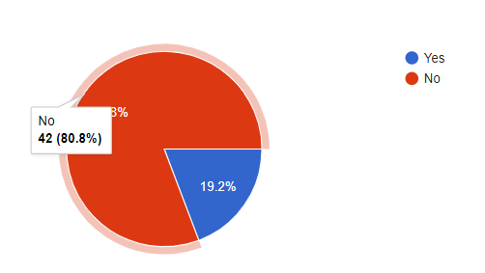
Data
209356U
Target Population is mobile banking app non-users in Sri Lanka
Questionnaire was prepared using Google forms
Data collected online
Total of 52 responses; both mobile banking app users and non-users
Some of the participants were not in the target population (over-coverage error)
42 responses from non-users
Analysis done for the 42 responses from non-users
Github repo link: https://github.com/Prabashi/MobileBankingAppNonUsers

Slide 3
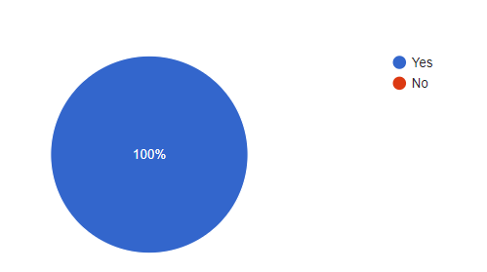
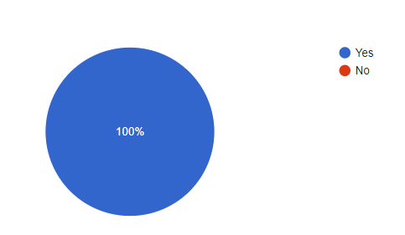
Respondents: Having a Mobile phone and having Bank Accounts
209356U

Slide 4
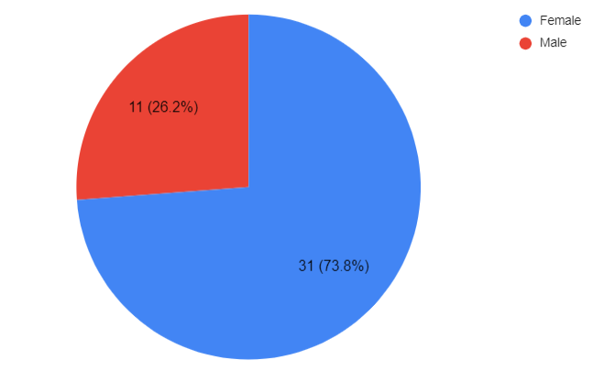
Respondents: Gender
209356U

Slide 5
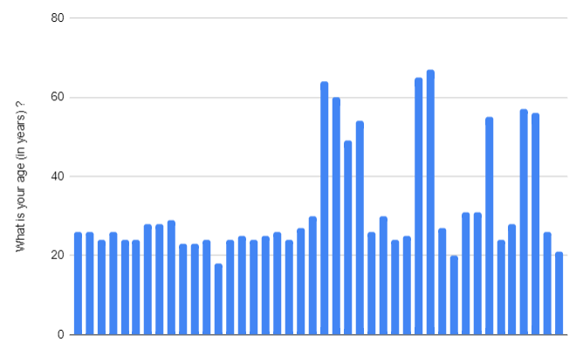
Respondents: Age in years
209356U

Slide 6
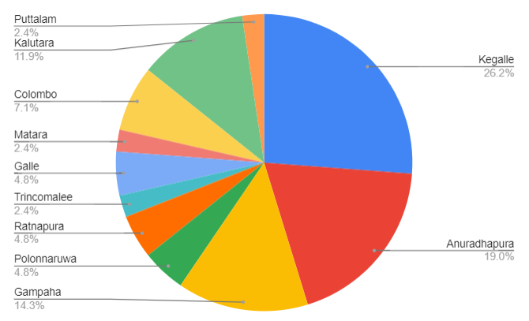
Respondents: Current place of living (District)
209356U

Slide 7
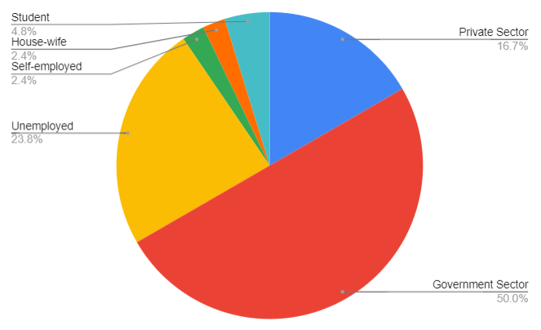
Respondents: Occupation
209356U

Slide 8
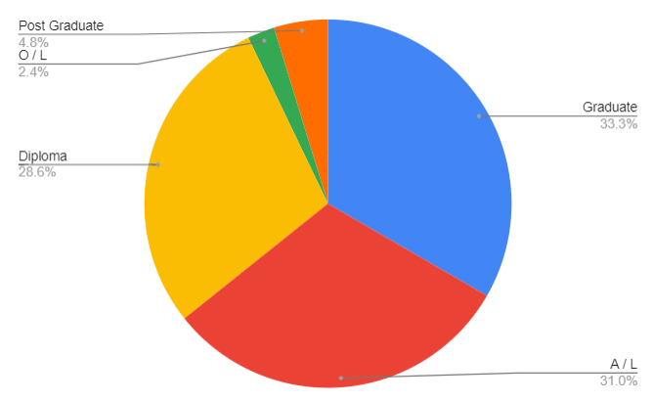
Respondents: Highest level of Education
209356U

Slide 9
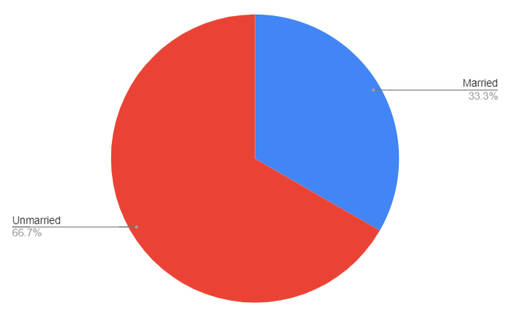
Respondents: Marital Status
209356U

Slide 10
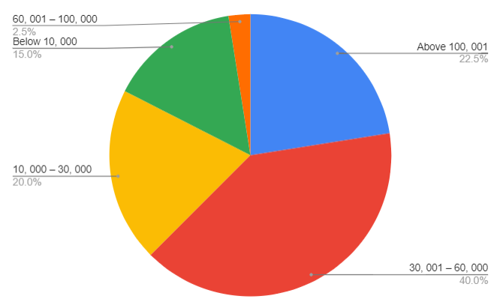
Respondents: Monthly income
209356U

Slide 11
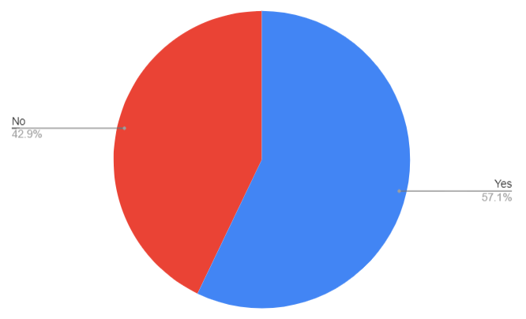
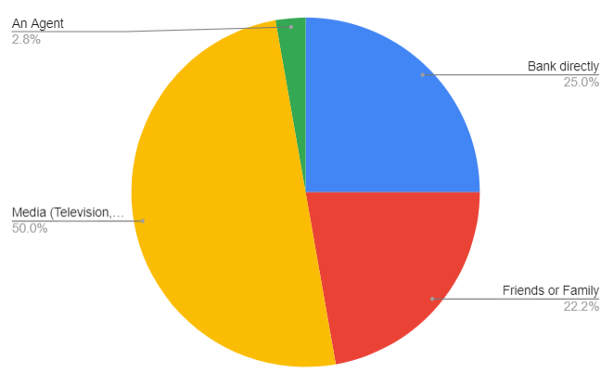
Respondents: Awareness on Mobile Banking Apps
209356U

Slide 12
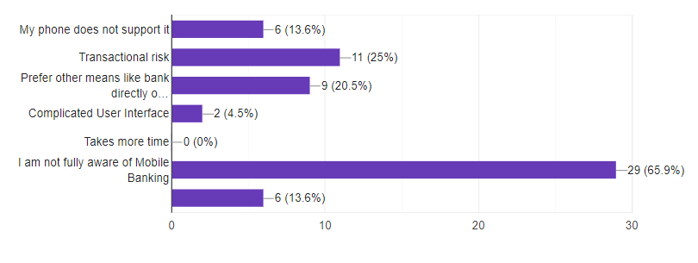
Respondents: Reasons for not using Mobile Banking Apps
209356U

Slide 13
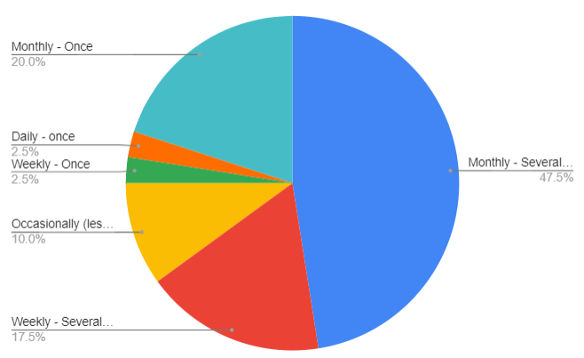
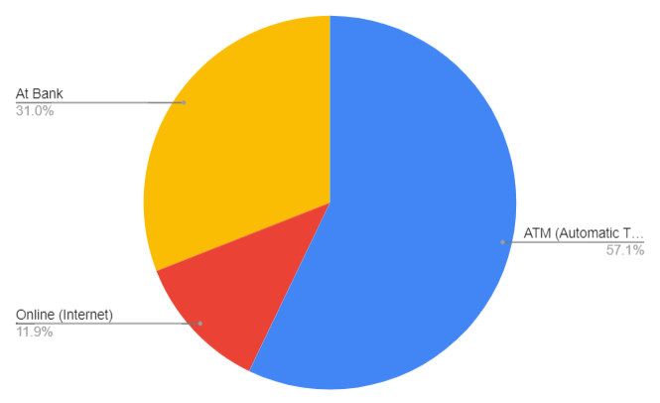
Respondents: Transaction Frequency and How
209356U

Slide 14
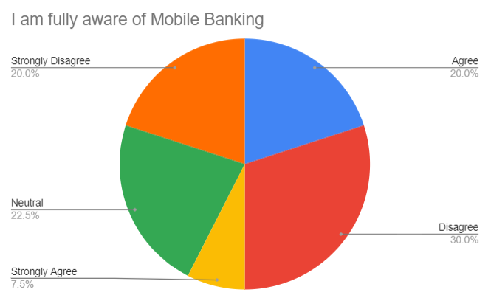
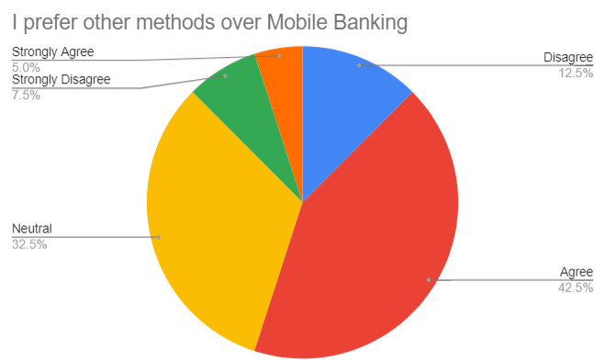
Respondents: Rankings regarding statements on Mobile Banking
209356U

Slide 15
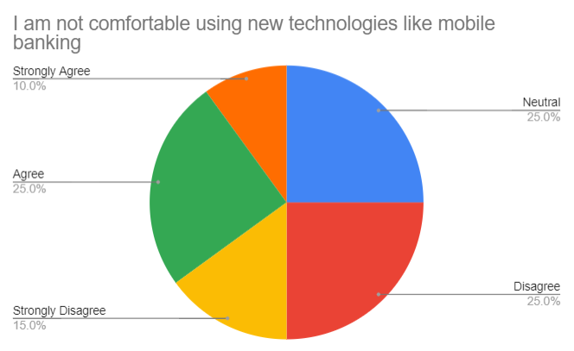
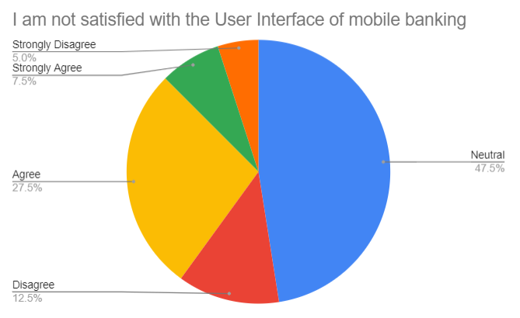
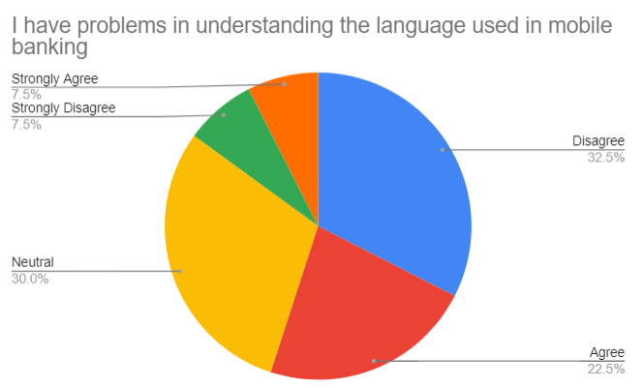
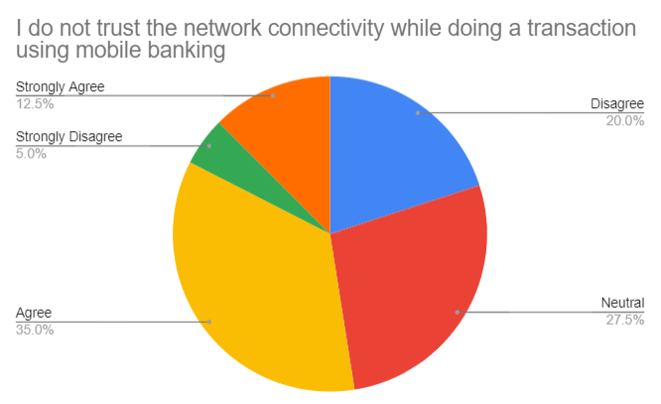
209356U

Slide 16
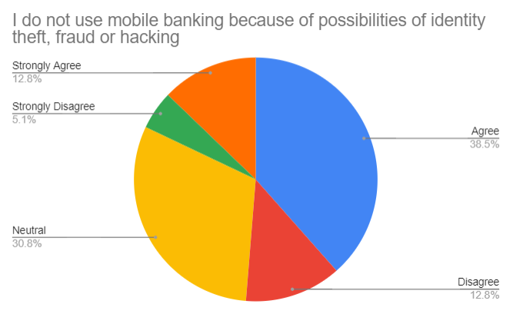
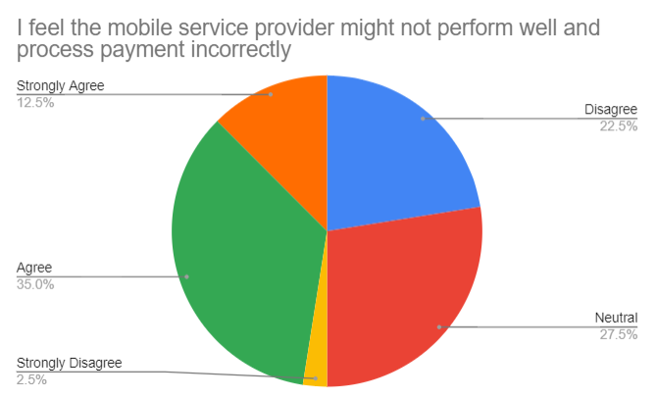
209356U

Slide 17
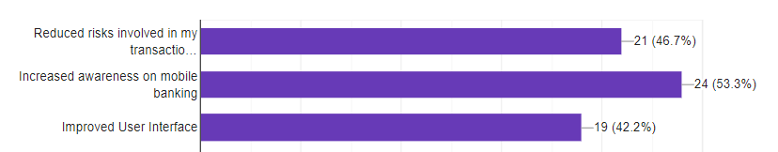
Respondents: Motivations to use Mobile Banking
209356U

Slide 18
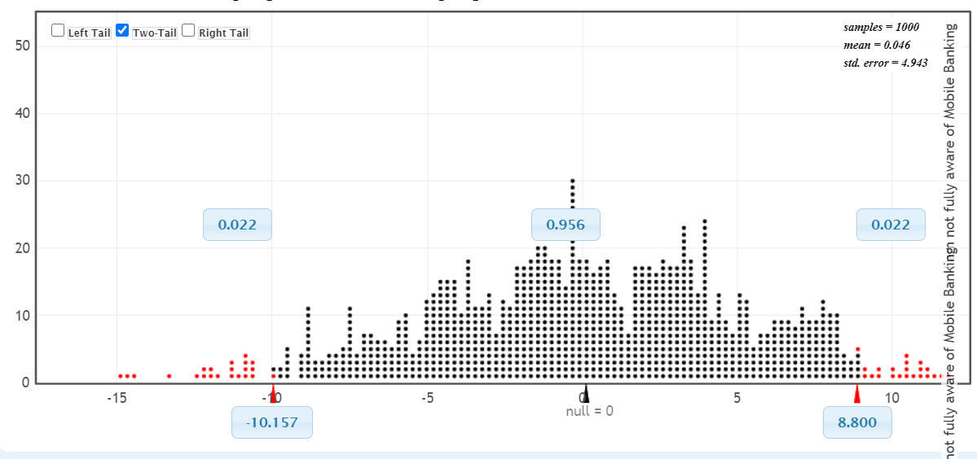
Hypothesis Testing
Null hypothesis: Mean of ages of respondents that are not fully aware of the mobile banking apps and mean of ages of respondents that are aware of mobile banking apps are equal

Slide 19
Conclusion
209356U
The mean age of people who are not aware of mobile banking apps are not equal to the mean age of people who are aware
According to data, the main reason for not using mobile banking apps is that the population is not fully aware of mobile banking apps
50% of the population get to know about mobile banking apps via Media
The sample is not truly random and therefore cannot finalize the conclusions for population

Slide 20
Thank You… Q & A

